Slide 1
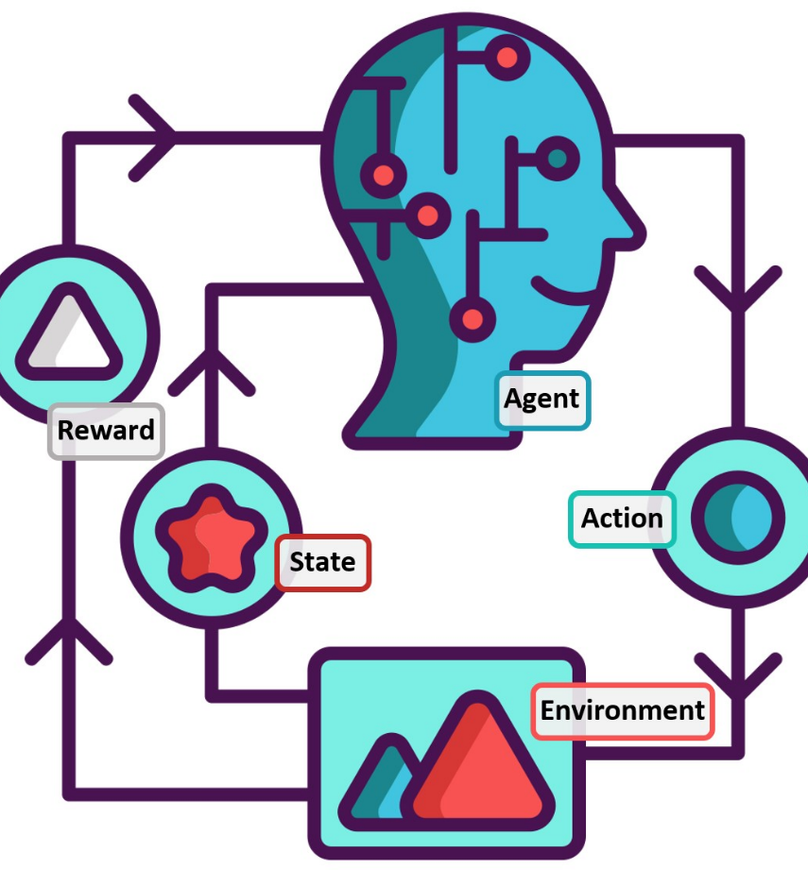
OPEN-AI GYM TAXI USING Q-LEARNING dsci-6612-02
Vijitha pyeta gouda kake
GAJULA CHAITANYA SAI

Slide 2
Taxi Environment
Taxi is one of many environments available on OpenAI Gym. These environments are used to develop and benchmark reinforcement learning algorithms.
The goal of Taxi is to pick-up passengers and drop them off at the destination in the least number of moves. In this project, we'll start with a taxi agent that takes actions randomly and train the agent to be a better taxi driver using reinforcement learning.

Slide 3


Installing OpenAI and Gym-Taxi
We'll be using the 'Taxi-v3' environment for this project.
- OpenAI Gym using the command: pip install gym
- NumPy using the command: pip install numpy
We'll need to install:

Slide 4
Random Agent
We'll start with an agent that doesn't learn at all. It will sample actions at random.
The first step is to give our agent an initial state of its environment.
- In this project, a state is defined as the current position of the taxi, pick-up and drop-off locations and the passenger.

Slide 5
Q Learning Agent
Q-learning algorithm is a reinforcement algorithm that tries find the best possible next action given its current state.
In order to maximize the reward, it decides which actions should it take, the actions can be up, down, left, right, pick-up or drop- off.
The 'Q' in Q-learning stands for quality which means how valuable an action is.

Slide 6
Terms used in Q Learning
Agent: An entity that can perceive/explore and act upon the environment.
Environment: A situation in which an agent is present or surrounded by. In RL, we assume the stochastic environment, which means it is random in nature.
Action: Actions are the moves taken by an agent within the environment.
State: State is a situation returned by the environment after each action taken by the agent.
Reward: Feedback returned to the agent from the environment to evaluate the action of the agent.
Policy: Policy is a strategy applied by the agent for the next action based on the current state.
Value: It is expected long-term return with the discount factor and opposite to the short-term reward.
Q-value: It is mostly similar to the value but takes one additional parameter as a current action.

Slide 7
Taxi reward system
There are 4 locations labelled with different letters and the job is to pick up the passenger at one location and drop him off at another.
We receive +20 points for a successful drop-off and lose 1 point for every timestep it makes.
There is also a 10 points penalty for any illegal pick-up and drop-off actions performed by the agent.

Slide 8

Now the next question that comes to mind is how but how will the agent know which action to take ?
This can be answered using the concept of Exploration strategy.

Slide 9

Exploration
Our agent currently has no way of knowing which action will lead to what .This is where trial-and-error comes in .
We’ll make our agent take random actions, and observe what rewards it gets, this is the gist of what we call exploring.
After many iterations, our agent will have observed that certain sequences of actions lead to more rewards than others.
During this, our agent will need to keep track of which actions led to what rewards and to keep track of this, we use the concept of Q tables.

Slide 10
Q-tables
A Q-table is a look-up table for storing values representing future rewards our agent can expect for a certain action in a certain state.
When our agent is in a specific state, Q tables will that the agent that some actions can lead to higher rewards than the others.
- It is kind of a cheat sheet that tells our agent the best actions available.
The higher the Q value, the greater the reward agent can get after taking that action.
As our agent explores, it will update the Q-table with the Q-values it finds.

Slide 11
The next question that comes to mind is how but how will the agent compute the Q values after every action?
This can be answered using the concept of Q learning algorithm.

Slide 12
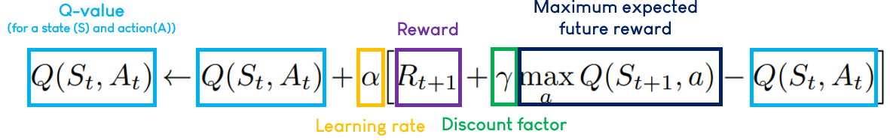
Q Learning Algorithm
The Q-learning algorithm would help our agent update the current Q-value with its observations after taking an action i.e., increase Q if it encountered a positive reward or decrease Q if it encountered a negative one.
The 'a' term refers to all the possible actions available for that state.
Learning rate (α): how easily the agent should accept new information over previously learnt information
Discount factor (γ): how much the agent should take into consideration the rewards it could receive in the future versus its immediate reward

Slide 13
Exploration- Exploitation strategy
We can let our agent explore updating our Q-table using the Q-learning algorithm. As our agent learns more about the environment, we can let it use this knowledge to take more optimal actions and converge faster - known as exploitation.
During exploitation, our agent will look at its Q-table and select the action with the highest Q-value (instead of a random action).
Over time, our agent will explore less and exploit what it knows instead.

Slide 14
Conclusion
We trained an agent who can pick up passengers and drop them off at their destination in the least number of moves.
This task is accomplished optimally using the concept of reinforcement learning (Q learning).

Slide 15
Thank you

